Slide 1
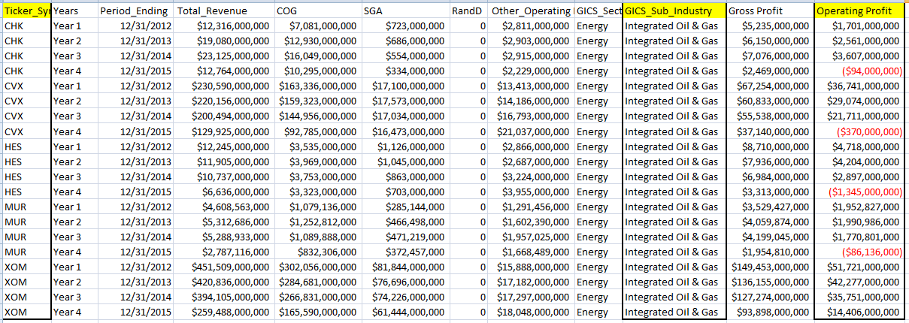
NYSE Data Project Presentation--- What difference did Oil and Gas companies have in their Operating Profit?
Screenshot 1 Five Oil & Gas Companies Financial Metrics (2012 to 2015) Calculation Summary
One GICS Sub Industry is included: Integrated Oil & Gas. There are 5 companies under this sub industry: CHK, CVX, HES, MUR, XOM.
Operating Profit is calculated and analyzed.
Operating Profit = Total Revenue – Cost of Goods – Total Operating Expenses (SGA + R&D + Other operating expenses)

Slide 2
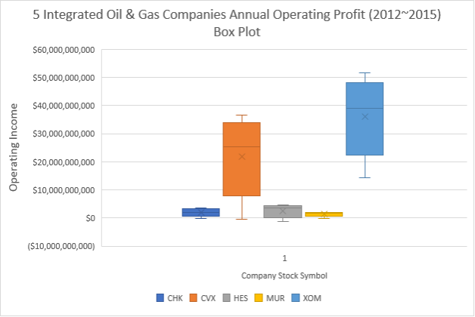
NYSE Data Project Presentation--- What difference did Oil and Gas companies have in their Operating Profit?
Table 1 Five Oil & Gas Companies Operating Profit (2012 to 2015) Statistics Summary
 | CHK | CVX | HES | MUR | XOM
min | ($94,000,000) | ($370,000,000) | ($1,345,000,000) | ($86,136,000) | $14,406,000,000
1/4 quartile | $1,252,250,000 | $16,190,750,000 | $1,836,500,000 | $1,306,566,750 | $30,414,750,000
median | $2,131,000,000 | $25,392,500,000 | $3,550,500,000 | $1,861,814,000 | $39,014,000,000
3/4 quartile | $2,822,500,000 | $30,990,750,000 | $4,332,500,000 | $1,962,366,750 | $44,638,000,000
max | $3,607,000,000 | $36,741,000,000 | $4,718,000,000 | $1,990,986,000 | $51,721,000,000
Range | $3,701,000,000 | $37,111,000,000 | $6,063,000,000 | $2,077,122,000 | $37,315,000,000
Std | $1,356,350,872 | $13,853,347,014 | $2,382,677,328 | $866,136,968 | $13,719,579,082
Accoring to Figure 1:
Insight 1: XOM has the highest median ($39,014,000,000 ) operating income compared to the other 4 companies.
Insight 2: CVX and XOM has a wider spread range ($37,111,000,000 & $37,315,000,000 respectively) of operating income compared to the other 3 companies.
Insight 3: the minimum operating income of XOM ($14,406,000,000 ) is higher than the maximum operating income of CHK, HES and MUR.
According to Table 1:
Insight 4: MUR has the smallest standard deviation ($866,136,968) compared to other 4 companies.
Insight 5: HES operating income range ($6,063,000,000) is almost three times of MUR operating income range ($2,077,122,000).
Figure 1 Five Oil & Gas Companies Operating Profit (2012 to 2015) Box Plot
Workbook can also be found here: https://1drv.ms/x/s!AgQgo2XVOlkGkz0U0gS4oLoR3TRV?e=0YfY0o

